Slide 1

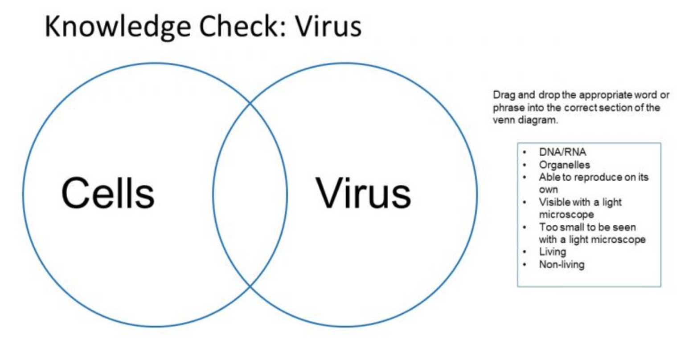
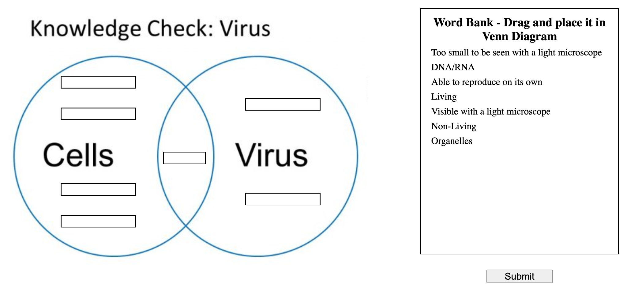
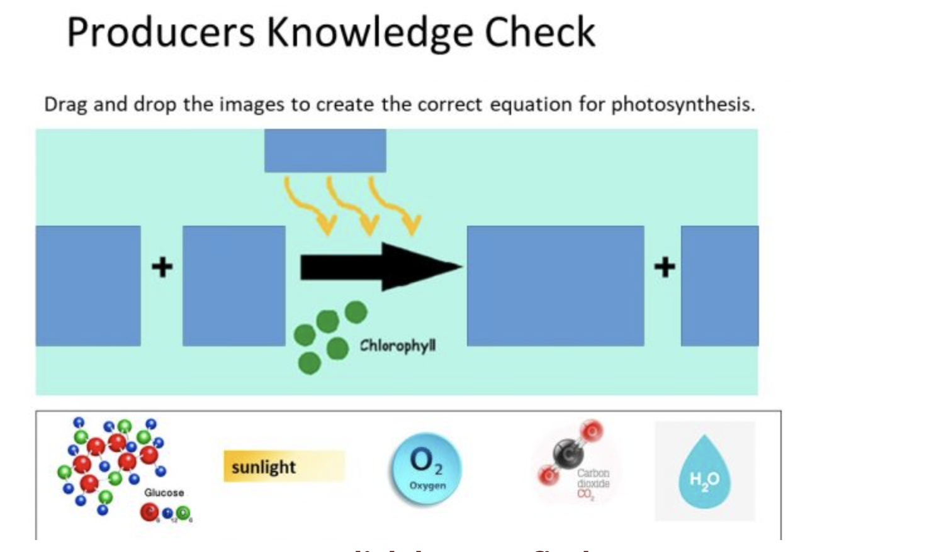
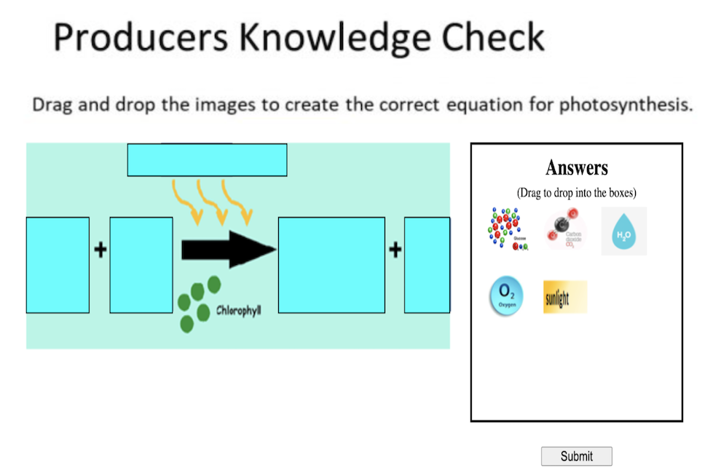
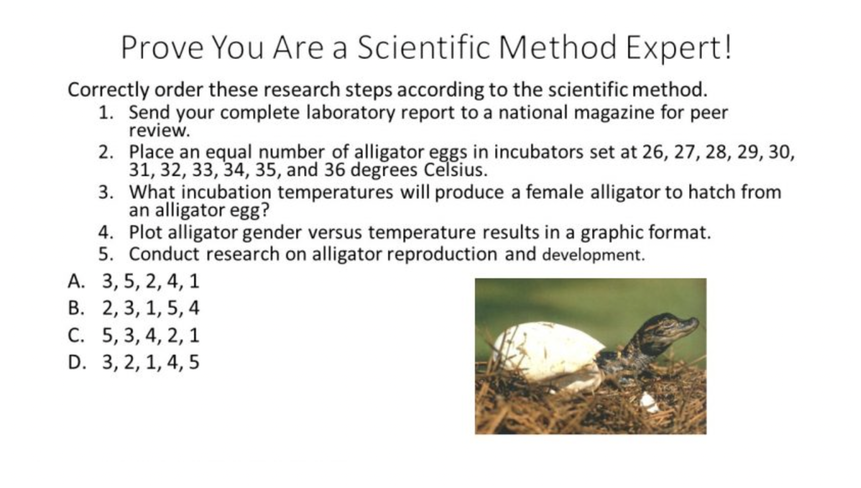
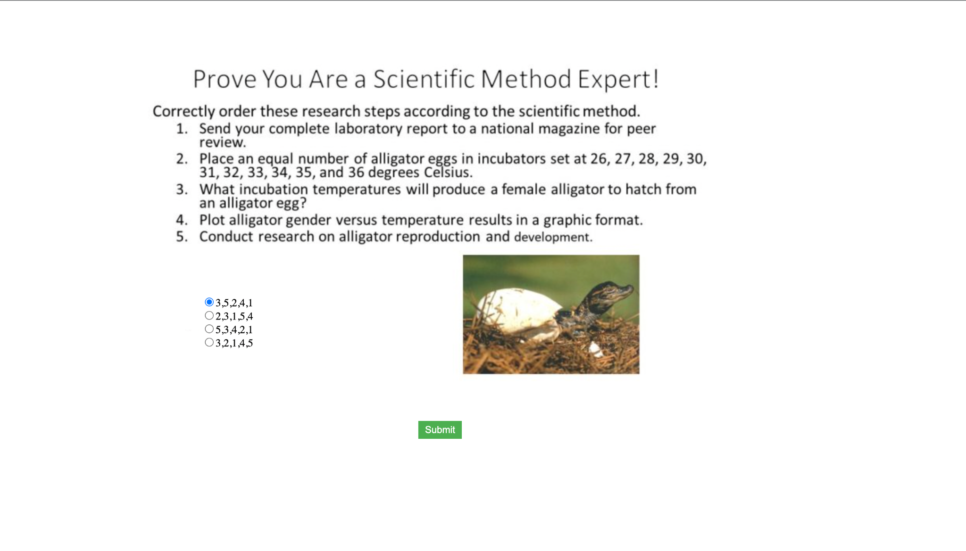
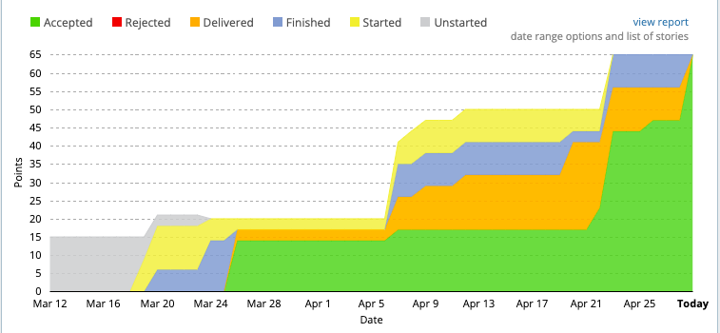
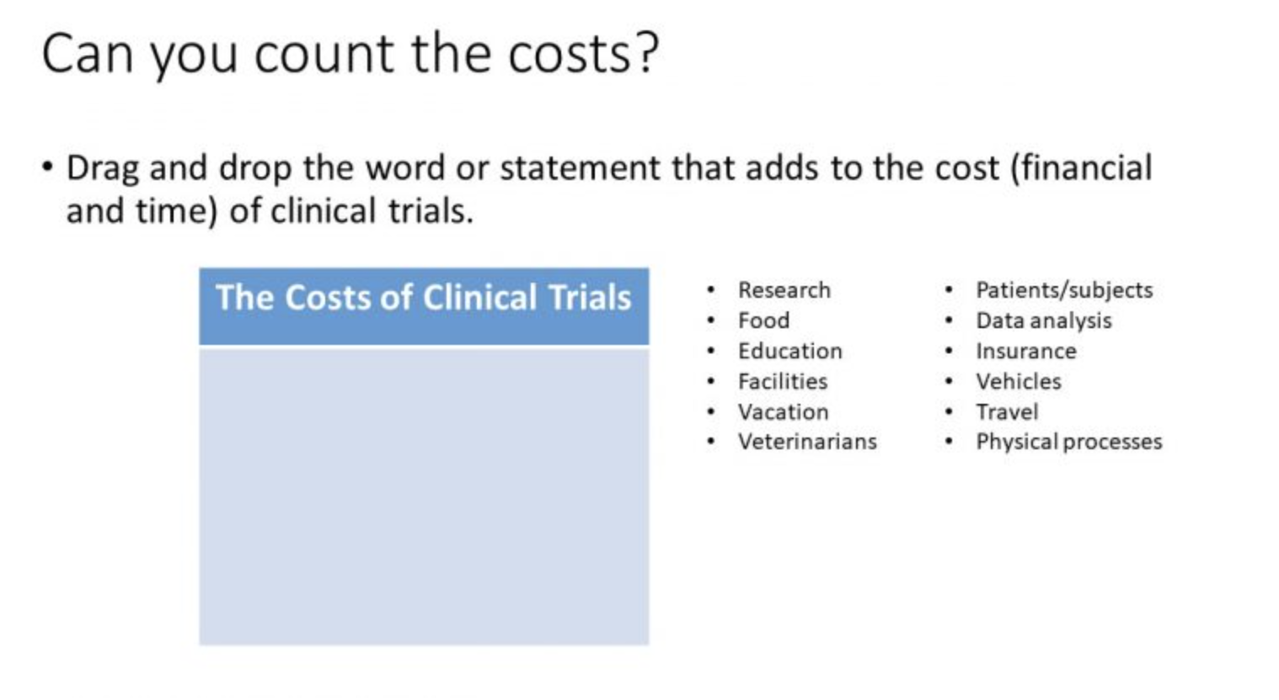
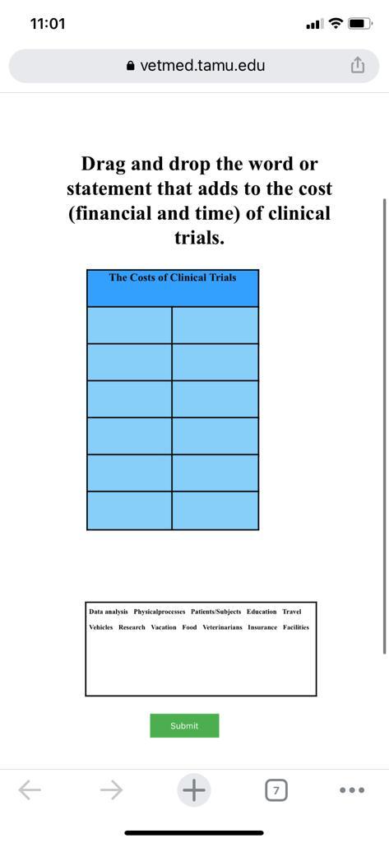
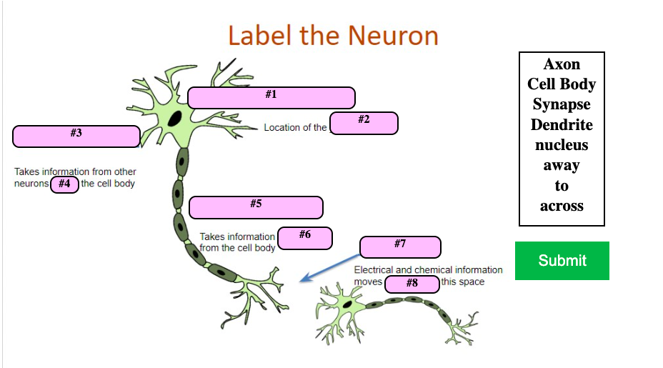
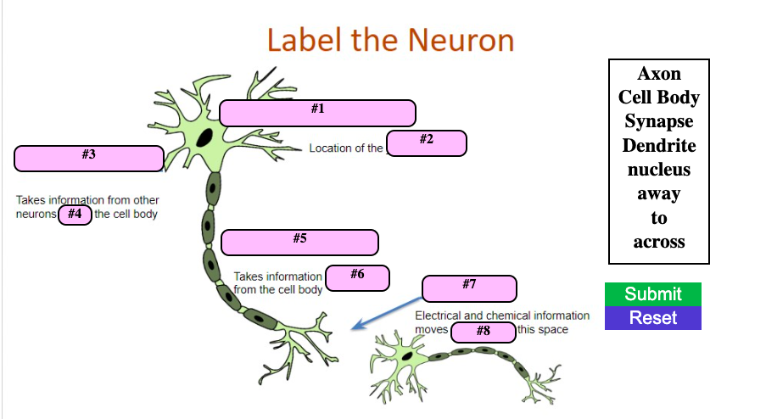
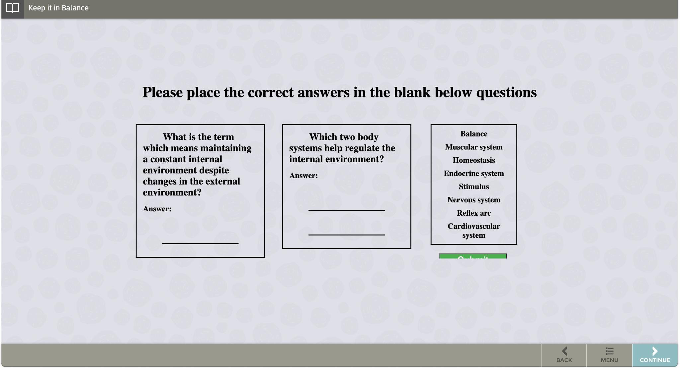
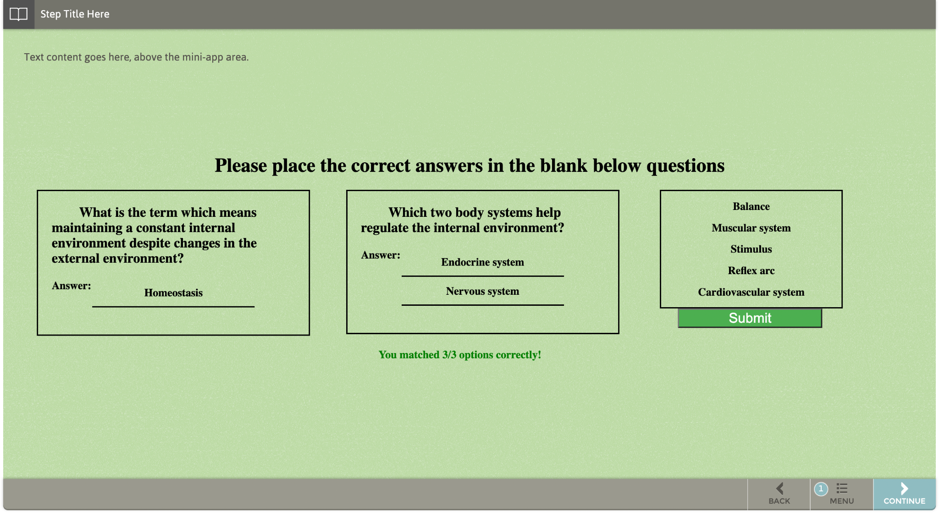
Vetmed Biology Learning Games and Animations
Apurva Purushotama, FNU Nimisha, Prajwal Das, Sai Harini Voruganti, Shubham Gupta
Department of Computer Science and Engineering, Texas A&M University
Introduction
Animation slides
Target customer: VetMed TAMU, Dr. Hank Walker
Goal: Aid middle school children to learn biological concepts through interactive games and animations.
Requirement: Developed and enhanced applications using JS/JQuery/HTML/CSS which are exposed through an existing platform called ‘StepStone’ and a WordPress based website.
Developed new drag and drop animations for the modules. The left figure below is the non interactive version and the right figure shows the version we developed.
Agile Workflow
ITERATION 0
ITERATION 1
Gathering requirements, preparing inventory sheet.
Reading documentations.
Understanding legacy code
Familiarizing JS, JQuery, HTML & CSS
Developing and testing four new drag and drop animations.
Verifying if the previous legacy code is correctly deployed on StepStone and WordPress.
Created new animations for the modules. The left figure below shows the non interactive version of the slide. The animation developed allows the user to drag and drop the image to form the right equation.
ITERATION 2
ITERATION 3
FINAL
Developing and testing five new drag & drop animations.
Ensuring all developments are compatible on mobile devices.
Developing, testing and deploying three new MCQ based animations and two drag and drop animations.
Developing two new animations and add features to three animations.
Ensuring all the developed slides are deployed on wordpress and StepStone.
Created new radio button animations for the modules. The left image below shows a comparison of the previous version with the latest version with our changes.
Developed the drag and drop animations. Ensured that the animations are compatible with mobile devices. The right image is the mobile view for the same.
Most of the animations developed were deployed to StepStone and WordPress environments after Iteration 3. Hence, in the above velocity graph, it can be seen that most points were accepted after Iteration 3.
Goals Achieved / Impact
Improved the UX of the application by adding a Reset button. Figure below shows a comparison between previous and modified version.
We successfully reached our desired goal, which was to develop interactive animations for various modules under OneHealth.
The animations were deployed on Stepstone and Wordpress for students to have a fun learning experience in understanding biology concepts.
The colors,images,font sizes for the animations were chosen keeping accessibility in mind.
The existing animations have also been made compatible for mobile devices and have been thoroughly tested on Stepstone and Wordpress.
Ensured customer feedback was incorporated in each iteration to achieve the desired goal.
.
Fixed the existing drag and drop portion and submit button functionality to verify the correct answers. Ensured that prompts indicating the number of correct answers works for partially filled inputs.
Challenges and learnings
Challenges faced:
Understanding the legacy project, documentations from the previous teams, code structure.
Inventory check: Mapping the code from different repositories with modules for which the animations were to be developed.
Majority of the existing animations were not mobile compatible.
The project does not have a CI/CD pipeline. We reached out to Daniel and Samkisha for our deployments.
Learnings:
Developing responsive and parameterized code.
Learned HTML, CSS, Javascript, JQuery.
Testing application thoroughly using DesktopServer and StepStone testing environment.
Generating code quality reports.
Effectively communicating with the client, deployment point of contacts and team members.
Sprint planning, agile development methodology.
Acknowledgements
We would like to thank Dr. Hank Walker, our instructor Dr. Philip Ritchey and TAs Abhishek Sinha and Akshit Kharbanda for their help in verifying our progress and providing inputs and feedback throughout the course of the project. We further extend our gratitude towards Daniel Shuta and Samiksha Marne for helping us understand the deployment process and making the developed animations reach the students by deploying them in Stepstone and Wordpress environments in a timely manner.

